Slide 1
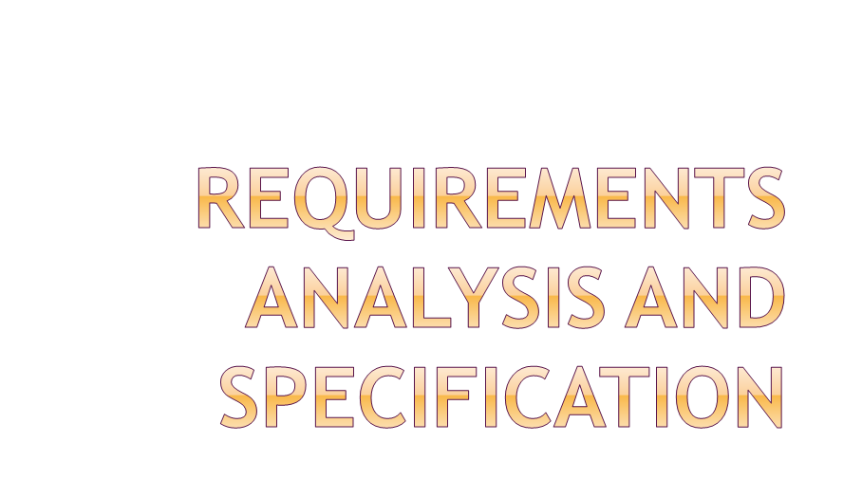
By Bonnie Computer Hub Team
By Bonnie Computer Hub Team

Slide 2

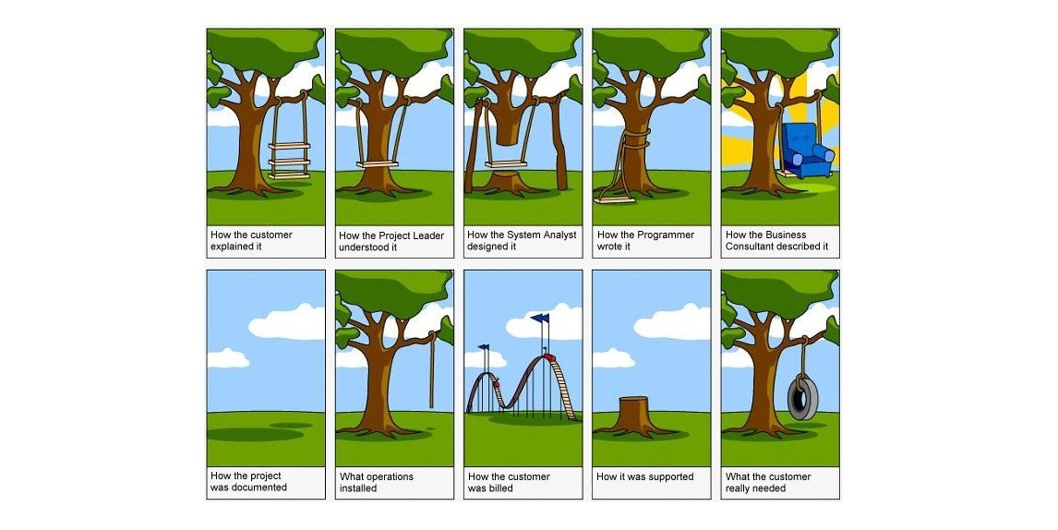
By Bonnie Computer Hub Team

Slide 3

Many projects fail:
  because they start implementing the system:
  without determining whether they are building what the customer really wants.
By Bonnie Computer Hub Team

Slide 4
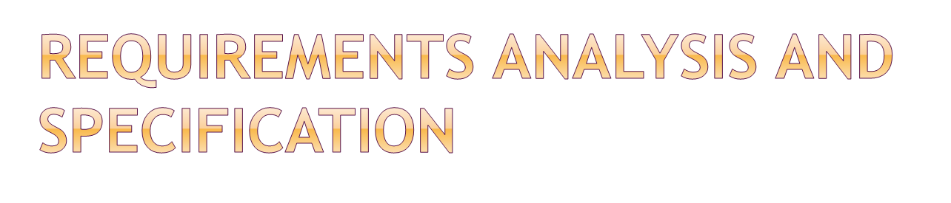
Goals of requirements analysis and specification phase:
  fully understand the user requirements
  remove inconsistencies, anomalies, etc. from requirements
  document requirements properly in an SRS document
By Bonnie Computer Hub Team

Slide 5

Systems analyst
The person who undertakes requirements analysis and specification
  collects data pertaining to the product
  analyzes collected data:
    to understand what exactly needs to be done.
  writes the Software Requirements Specification (SRS) document.
By Bonnie Computer Hub Team

Slide 6

Software Requirements Specification (SRS) Document
Final output of this phase:
Reviewed by the customer.
  reviewed document forms the basis of all future development activities.
By Bonnie Computer Hub Team

Slide 7

Requirement is a condition or a capability needed by the user to solve a problem and to achieve an objective.
By Bonnie Computer Hub Team

Slide 8

Requirement analysis is the process of studying and analyzing the customer and the user needs to arrive at a definition of the problem domain and system requirements
By Bonnie Computer Hub Team

Slide 9
Requirements analysis consists of two main activities:
  Requirements gathering
  Analysis of the gathered requirements
By Bonnie Computer Hub Team

Slide 10
Analyst gathers requirements through:
  observation of existing systems,
  studying existing procedures,
  discussion with the customer and end-users,
  analysis of what needs to be done, etc.
By Bonnie Computer Hub Team

Slide 11

If the project is to automate some existing procedures
  e.g., automating existing manual accounting activities,
  the task of the system analyst is a little easier
  analyst can immediately obtain:
    input and output formats
    accurate details of the operational procedures
By Bonnie Computer Hub Team

Slide 12
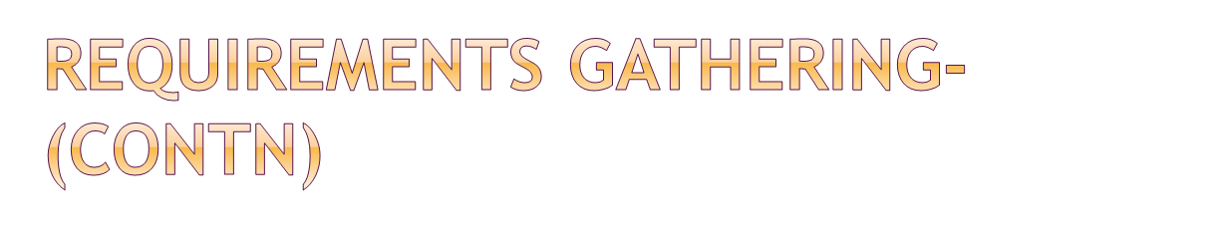
In the absence of a working system,
  lot of imagination and creativity are required.
Interacting with the customer to gather relevant data:
  requires a lot of experience.
By Bonnie Computer Hub Team

Slide 13

After gathering all the requirements:
  analyze it:
    Clearly understand the user requirements,
    Detect inconsistencies, ambiguities, and incompleteness.
Incompleteness and inconsistencies:
  resolved through further discussions with the end-users and the customers.
By Bonnie Computer Hub Team

Slide 14
Requirements analysis involves:
  obtaining a clear, in-depth understanding of the product to be developed,
  remove all ambiguities and inconsistencies from the initial customer perception of the problem.
By Bonnie Computer Hub Team

Slide 15
Several things about the project should be clearly understood by the analyst:
  What is the problem?
  Why is it important to solve the problem?
  What are the possible solutions to the problem?
  What complexities might arise while solving the problem?
By Bonnie Computer Hub Team

Slide 16
After collecting all data regarding the system to be developed,
  remove all inconsistencies and anomalies from the requirements,
  systematically organize requirements into a Software Requirements Specification (SRS) document.
By Bonnie Computer Hub Team

Slide 17

Specification is the description of each of the essential requirements of the software and the external interface
Main aim of requirements specification:
  systematically organize the requirements arrived during requirements analysis
  document requirements properly.
By Bonnie Computer Hub Team

Slide 18

The SRS document is useful in various contexts:
  statement of user needs
  contract document
  reference document
  definition for implementation
By Bonnie Computer Hub Team

Slide 19
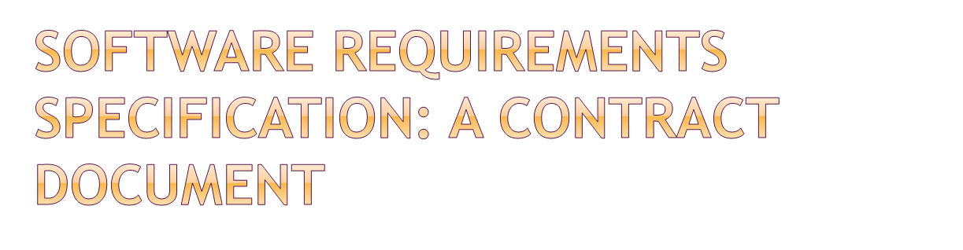
Requirements document is a reference document.
SRS document is a contract between the development team and the customer.
  Once the SRS document is approved by the customer,
    any subsequent controversies are settled by referring the SRS document.
By Bonnie Computer Hub Team

Slide 20
Once customer agrees to the SRS document:
  development team starts to develop the product according to the requirements recorded in the SRS document.
The final product will be acceptable to the customer:
  as long as it satisfies all the requirements recorded in the SRS document.
By Bonnie Computer Hub Team

Slide 21
SRS document concentrates on:
  what needs to be done(that’s why requirements phase is considered as ‘what’ phase)
  carefully avoids the solution (“how to do”) aspects.
The SRS document serves as a contract
  between development team and the customer.
  Should be carefully written
By Bonnie Computer Hub Team

Slide 22

One of the fundamental objectives of any project is to collect all types of requirements. These need to be kept in balance and harmony, and most importantly not compromised as the project progresses
By Bonnie Computer Hub Team

Slide 23

Functional Requirements.
Non-functional Requirements
By Bonnie Computer Hub Team

Slide 24

"A functional requirement specifies a function that a system or component must be able to perform."
  Statements of services the system should provide, how the system should react and behave in a certain condition.
By Bonnie Computer Hub Team

Slide 25

Describe functionality or system services
Describe what the system must do
Functional system requirements describe system services in detail
Characterized by verbs
By Bonnie Computer Hub Team

Slide 26

“The system must process withdrawals and dispense cash”
“The user shall be able to search either all databases or specify a subset”.
“The system shall provide appropriate viewers for the user to read documents”.
"Display the heart rate, blood pressure and temperature of a patient connected to the patient monitor."
By Bonnie Computer Hub Team

Slide 27

Non-functional requirements describe the qualities and standards the system under development should comply with but which are not tasks automated as part of the system.
These define system properties and constraints e.g. reliability, response time and storage requirements. Constraints are I/O device capability, system representations, etc.
By Bonnie Computer Hub Team

Slide 28

Characteristics of the system which can not be expressed as functions:
    maintainability,
    portability,
    Reliability,
    usability, etc.
By Bonnie Computer Hub Team

Slide 29
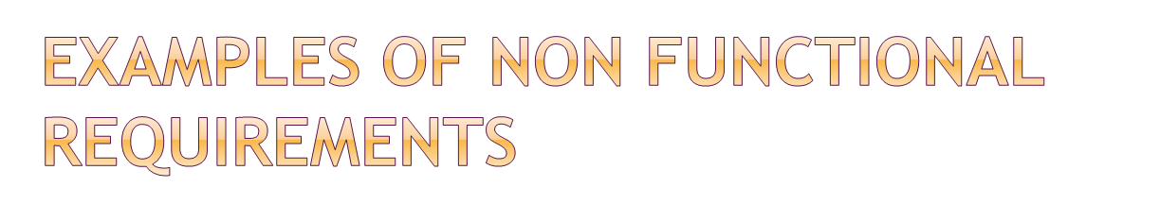
“The system should be fast and efficient”
"Display of the patient's vital signs must respond to a change in the patient's status within 2 seconds."
By Bonnie Computer Hub Team

Slide 30

Non-functional requirements should be measurable
Whenever possible, we should write non-functional requirements quantitatively, so that they can be tested.
By T. Sawe

Slide 31
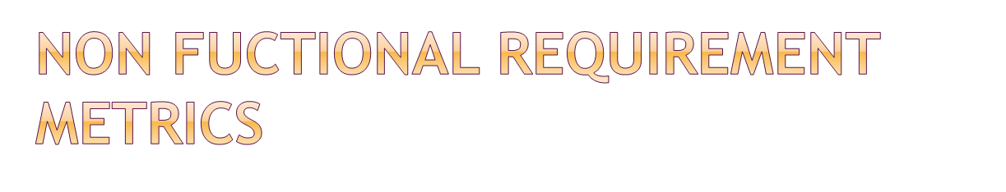
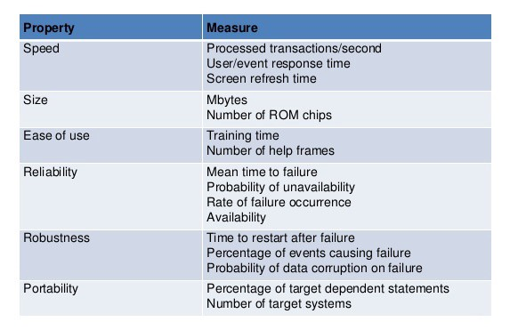
By Bonnie Computer Hub Team

Slide 32

Processes used to discover, analyse and validate system requirements
Involves capturing, structuring, and accurately representing the user's requirements so that they can be correctly embodied in systems which meet those requirements (i.e. are of good quality).
By Bonnie Computer Hub Team

Slide 33
It focuses on assessing if the system is useful to the business (feasibility study), discovering requirements (elicitation and analysis), converting these requirements into some standard format (specification), and checking that the requirements define the system that the customer wants (validation).
In practice, requirements engineering isn’t sequential process, it’s an iterative process in which activities are interleaved.
By Bonnie Computer Hub Team

Slide 34
Requirements engineering helps software engineers to better understand the problem they will work to solve.
It encompasses the set of tasks that lead to an understanding of what the business impact of the software will be, what the customer wants and how end-users will interact with the software.
By Bonnie Computer Hub Team

Slide 35

Requirements engineering is composed of four key activities –
-feasibility study,
-requirements elicitation,
-requirements analysis,
- requirements validation.
-Requirement management
By Bonnie Computer Hub Team

Slide 36
1. Feasibility study
A feasibility study decides whether or not the proposed system is worthwhile.
A short focused study that checks
  If the system contributes to organisational objectives;
  If the system can be engineered using current technology and within budget;
  If the system can be integrated with other systems that are used.
By T. Sawe

Slide 37

The results of the feasibility study should be a report that recommends whether to go forward to the next process or you won’t be able to implement the software at all.
By Bonnie Computer Hub Team

Slide 38
2. Requirements elicitation
Requirement elicitation is the action of discovering system requirements through consultation with stakeholders. Some of the sources of this discovery could be system documents, domain knowledge, and market studies.
By Bonnie Computer Hub Team

Slide 39
Requirements elicitation
Involves technical staff working with customers to find out about the application domain, the services that the system should provide and the system’s operational constraints
By Bonnie Computer Hub Team

Slide 40
Requirements elicitation(Methods)
Different methods of elicititation are used which include
-Interviews,
-Brainstorming session,
-Facilitated Application Specification Technique(FAST),
-Quality Function Deployment(QFD), etc.
By Bonnie Computer Hub Team

Slide 41
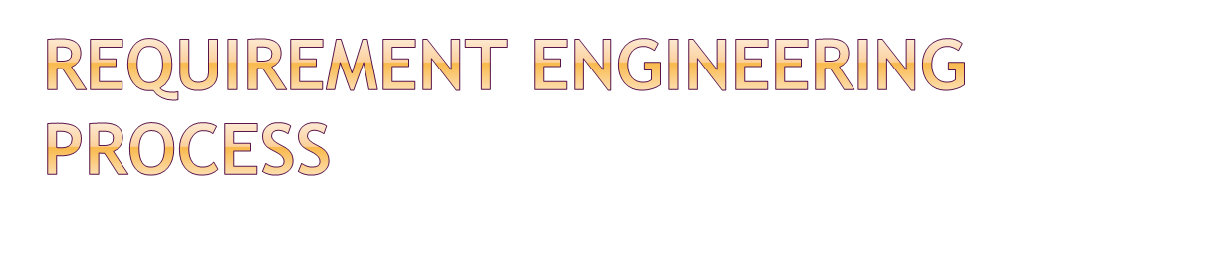
Requirements elicitation(Methods)
2.1 Interviews: A typical conversational method is interviews where analyst discusses the desired product with different stakeholders and develops an understanding of their requirements. Generally Interviews are divided in two groups
1.Closed Interview: prepare some predefined questions and try to get the answers for these questions for the stakeholder.
2.Open-ended Interview: we do not need to prepare any predefined questions, and the information from the stakeholders in open discussions.
By Bonnie Computer Hub Team

Slide 42
Requirements elicitation(Methods)
2.2 Brainstorming sessions: Futrell et al. (2002, pg. 523) describes brainstorming as “a group technique that may be used during the requirements-gathering process to promote creative thinking.
Brainstorming for requirements is useful as it generates a large amount of them, even if they are not true or possible to implement. Each generated requirement is recorded and explored, to see if it is actually important.
By Bonnie Computer Hub Team

Slide 43
Requirements elicitation(Methods)
2.3 Facilitated Application Specific Techniques (FAST):
The objective of this method is to bridge the gap between the customer and the developer. Tasks involved are
-Conduct a meeting at a neutral site with developers and stakeholders present
-Generate an informal agenda
-Require a facilitator to enable the meeting to run smoothly(The facilitator can either be a customer or a developer)
By Bonnie Computer Hub Team

Slide 44
Requirements elicitation(Methods)
2.4 Quality Function Deployment (QFD): QFD emphasizes the understanding of what is valuable to the customer and then deploy these values throughout the development process.These stages include
gathering high-level customer requirements
constructing a set of system features that can satisfy customer needs
creating a scale to evaluate system features against satisfaction of customer needs
(e.g. a 5 point scale 1. V. important 2.Important 3. Less Important 4. Not important 5. Unrealistic )
By Bonnie Computer Hub Team

Slide 45
3.Requirement Analysis
Requirement analysis is scrutinizing the gathered requirements in order to make consistent and unambiguous requirements.
It also involves providing the graphical view of the system using the requirements. This is done by the use of context diagram and Data Flow Diagram(DFD)
By Bonnie Computer Hub Team

Slide 46

1. Context Diagram
Context diagram is a diagram that defines the boundary between the system, or part of a system, and its environment, showing the entities that interact with it. This diagram is a high level view of a system.
By Bonnie Computer Hub Team

Slide 47
Context diagram
It shows the name of the system of interest in a circle with the circumference of the circle representing the system boundary. Rectangles outside the circle represent external entities which could be user classes, actors, organizations, other software systems or hardware devices that interface to the system.
By Bonnie Computer Hub Team

Slide 48

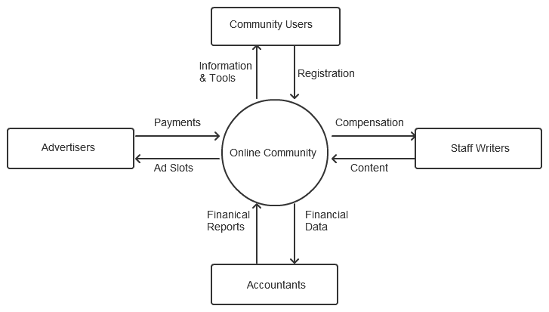
By Bonnie Computer Hub Team

Slide 49
2. Data Flow Diagram
A DFD represents flow of data through a system. Data flow diagrams are commonly used during problem analysis. It views a system as a function that transforms the input into desired output. A DFD shows movement of data through the different transformations or processes in the system.
By Bonnie Computer Hub Team

Slide 50

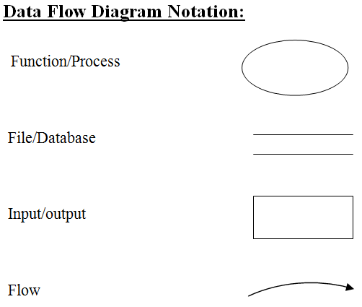
By Bonnie Computer Hub Team

Slide 51
4. Requirement Validation
Requirement validation is the process of reviewing requirements for clarity, consistency and completeness.
Requirements validation is concerned with showing that the requirements actually define the system that the customer wants.
By Bonnie Computer Hub Team

Slide 52

Requirements error costs are high so validation is very important
  Fixing a requirements error after delivery may cost up to 100 times the cost of fixing an implementation error.
By Bonnie Computer Hub Team

Slide 53

5. Requirements management: Requirements management is the process of managing changing requirements during the requirements engineering process and system development.
By Bonnie Computer Hub Team

Slide 54
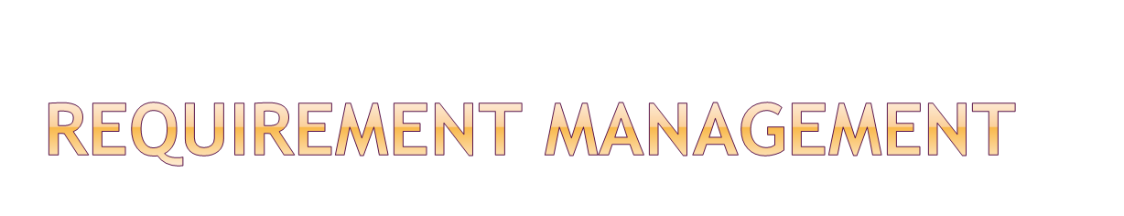
Requirements are inevitably incomplete and inconsistent
  New requirements emerge during the process as business needs change and a better understanding of the system is developed;
  Different viewpoints have different requirements and these are often contradictory.
By Bonnie Computer Hub Team

